Slide 1


Dr. D. Y. Patil Pratishthan's Institute for Advanced Computing and Software Development
C Programming

Slide 2
Today We discuss the following topics:-
-- C Control Statements
--Decision & Selection Control Statements
--Looping Statements
--Break
--Continue
--Type Casting

Slide 3
C Control Statements
Decision & Selection Control Statements:-if –else,switch case, conditional operators
Looping :-While,do—while,for
Branching :-break,continue,return, goto

Slide 4
C if else Statement
The if-else statement in C is used to perform the operations based on some specific condition. The operations specified in if block are executed if and only if the given condition is true.
There are the following variants of if statement in C language.
If statement
If-else statement
If else-if ladder
Nested if

Slide 5
If Statement
The if statement is used to check some given condition and perform some operations depending upon the correctness of that condition. It is mostly used in the scenario where we need to perform the different operations for the different conditions. The syntax of the if statement is given below.
if(expression){
//code to be executed
}

Slide 6
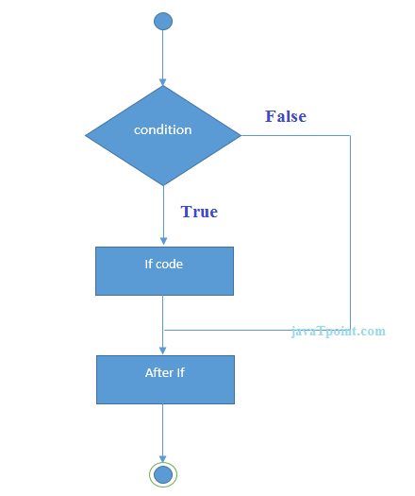
Flowchart of if statement in C

Slide 7
If-else Statement
The if-else statement is used to perform two operations for a single condition. The if-else statement is an extension to the if statement using which, we can perform two different operations, i.e., one is for the correctness of that condition(i.e true part), and the other is for the incorrectness of the condition(i.e false part). Here, we must notice that if and else block cannot be executed simultaneously Using if-else statement is always preferable since it always invokes an otherwise case with every if condition.

Slide 8
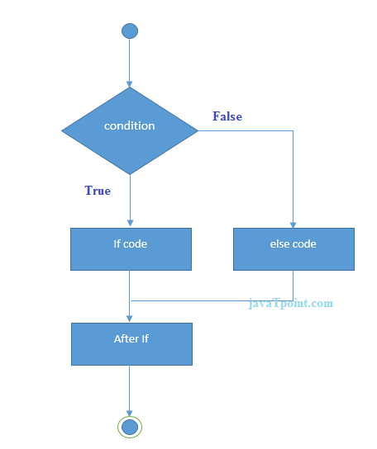
Syntax & Flowchart of if---else
if(expression)
{
//code to be executed if condiion is true
}
else{
//code to be executed if condition is false
}

Slide 9
If else-if ladder Statement
The if-else-if ladder statement is an extension to the if-else statement. It is used in the scenario where there are multiple cases to be performed for different conditions. In if-else-if ladder statement, if a condition is true then the statements defined in the if block will be executed, otherwise if some other condition is true then the statements defined in the else-if block will be executed, at the last if none of the condition is true then the statements defined in the else block will be executed.

Slide 10
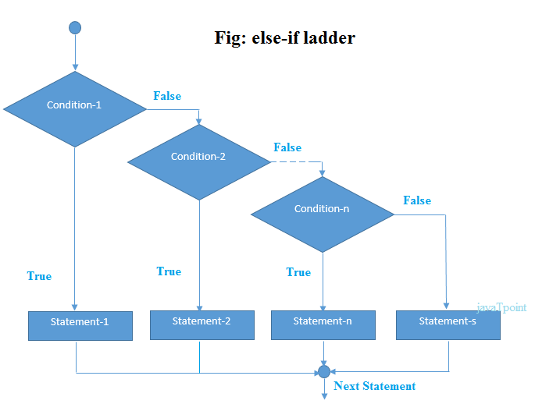
Syntax & Flowchart:-
if(condition1)
{
//code to be executed if condition1 is true
}else if(condition2){
//code to be executed if condition2 is true
}
else if(condition3){
//code to be executed if condition3 is true
}
...
else{
//code to be executed if all the conditions are false
}

Slide 11
Nested if—else
if(Condition1)//outer
{
if(Condition2)//inner
{
Statements;
else{
Statements;
}
if(condition3)
{-----}
else{
--------}
}

Slide 12
Conditional Operator(Ternary Operator)
Syntax:-
Expression1 ?Expression 2 :Expression3
Max=(num1>num2)? num1:num 2;

Slide 13
C Switch Statement
The switch statement in C is an alternate to if-else-if ladder statement which allows us to execute multiple operations for the different possibles values of a single variable called switch variable. Here, We can define various statements in the multiple cases for the different values of a single variable.
The Switch case statements is used for selective decision.
The keyword switch is followed by an expressions which must yield an integer or character value.

Slide 14
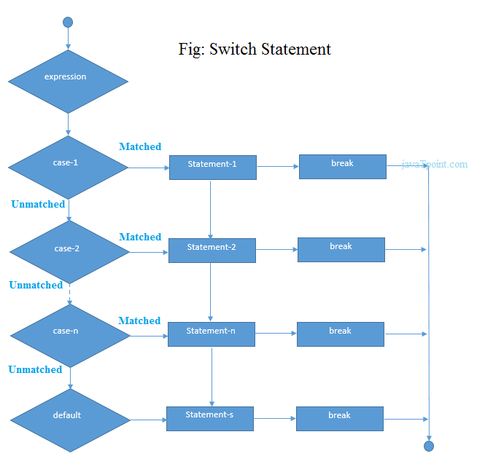
Syntax of Switch & Flowchart:-
switch(expression){
case value1:
//code to be executed;
break;
case value2:
//code to be executed;
break;
......
default:
code to be executed if all cases are not matched;
}

Slide 15
Rules for switch statement in C language
1) The switch expression must be of an integer or character type.
2) The case value must be an integer or character constant.
3) The case value can be used only inside the switch statement.
4) The break statement in switch case is not must. It is optional. If there is no break statement found in the case, all the cases will be executed present after the matched case. It is known as fall through the state of C switch statement.

Slide 16
Example:-
int x,y,z; case 1:2: 3 (invalid) case 1:
case 1:2:3(not allowed)
char a,b;
float f;
Valid Switch | Invalid Switch | Valid Case | Invalid Case
switch(x) | switch(f) | case 3; | case 2.5;
switch(x>y) | switch(x+2.5) | case 'a'; | case x;
switch(a+b-2) |  | case 1+2; | case x+2;
switch(func(x,y)) |  | case 'x'>'y'; | case 1,2,3;

Slide 17
C Loops
Loops are used when a task needs to be repeated a number of times
For example
Printing numbers from 1 to 100;
Printing even numbers from 1 to 50
Printing details of all bank customers
Sequentially searching a record in a file
Loops can be categorized as
1 Pre tested loop
2 Post tested loop

Slide 18
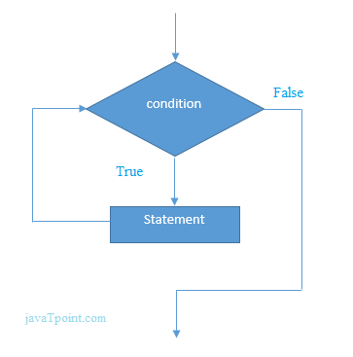
while loop in C
The while loop in c is to be used in the scenario where we don't know the number of iterations in advance. The block of statements is executed in the while loop until the condition specified in the while loop is satisfied. It is also called a pre-tested loop.
The syntax of while loop in c language is given below:
while(condition)
{
//code to be executed
}

Slide 19
Properties of while loop
A conditional expression is used to check the condition. The statements defined inside the while loop will repeatedly execute until the given condition fails.
The condition will be true if it returns 0. The condition will be false if it returns any non-zero number.
In while loop, the condition expression is compulsory.
Running a while loop without a body is possible.
We can have more than one conditional expression in while loop.
If the loop body contains only one statement, then the braces are optional.

Slide 20
for loop in C
The for loop in C language is used to iterate the statements or a part of the program several times. It is frequently used to traverse the data structures like the array and linked list.
The for loop is used in the case where we need to execute some part of the code until the given condition is satisfied. The for loop is also called as a per-tested loop. It is better to use for loop if the number of iteration is known in advance.
for(Expression 1; Expression 2; Expression 3){
//code to be executed
}

Slide 21
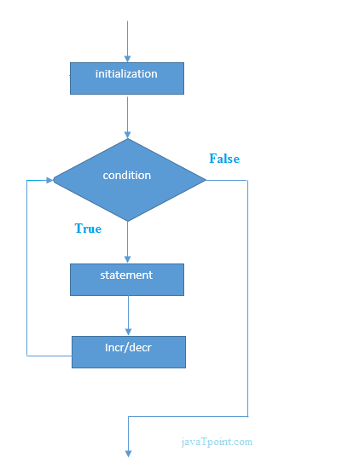
Flowchart:-

Slide 22
for loop in C
Properties of Expression 1 i=1
The expression represents the initialization of the loop variable.
We can initialize more than one variable in Expression 1.
Expression 1 is optional.
In C, we can not declare the variables in Expression 1. However, It can be an exception in some compilers.

Slide 23
for loop in C
Properties of Expression 2
Expression 2 is a conditional expression. It checks for a specific condition to be satisfied. If it is not, the loop is terminated.
Expression 2 can have more than one condition. However, the loop will iterate until the last condition becomes false. Other conditions will be treated as statements.
Expression 2 is optional.
Expression 2 can perform the task of expression 1 and expression 3. That is, we can initialize the variable as well as update the loop variable in expression 2 itself.
We can pass zero or non-zero value in expression 2. However, in C, any non-zero value is true, and zero is false by default.

Slide 24
for loop in C
Properties of Expression 3
Expression 3 is used to update the loop variable.
We can update more than one variable at the same time.
Expression 3 is optional.
Loop body
The braces {} are used to define the scope of the loop. However, if the loop contains only one statement, then we don't need to use braces. A loop without a body is possible. The braces work as a block separator, i.e., the value variable declared inside for loop is valid

Slide 25
do while loop in C
The do while loop is a post tested loop. Using the do-while loop, we can repeat the execution of several parts of the statements. The do-while loop is mainly used in the case where we need to execute the loop at least once. The do-while loop is mostly used in menu-driven programs where the termination condition depends upon the end user.
Syntax:-
do{
//code to be executed
}while(condition);

Slide 26
Nested Loops in C
C supports nesting of loops in C. Nesting of loops is the feature in C that allows the looping of statements inside another loop. Let's observe an example of nesting loops in C.
Any number of loops can be defined inside another loop, i.e., there is no restriction for defining any number of loops. The nesting level can be defined at n times. You can define any type of loop inside another loop; for example, you can define 'while' loop inside a 'for' loop.

Slide 27
Nested Loops in C
C supports nesting of loops in C. Nesting of loops is the feature in C that allows the looping of statements inside another loop. Let's observe an example of nesting loops in C.
Any number of loops can be defined inside another loop, i.e., there is no restriction for defining any number of loops. The nesting level can be defined at n times. You can define any type of loop inside another loop; for example, you can define 'while' loop inside a 'for' loop.

Slide 28
Syntax of Nested loop
Outer_loop
{
Inner_loop
{
// inner loop statements.
}
// outer loop statements.
}

Slide 29
Nested for loop
for(int i=1;i<=n;i++) // outer loop
{
for(int j=1;j<=10;j++) // inner loop
{
printf("%d\t",(i*j)); // printing the value.
}
printf("\n");

Slide 30
Nested while loop
while(condition)
{
while(condition)
{
// inner loop statements.
}
// outer loop statements.
}

Slide 31
Nested do while loop
do
{
do
{
// inner loop statements.
}while(condition);
// outer loop statements.
}while(condition);

Slide 32
C break statement
The break is a keyword in C which is used to bring the program control out of the loop. The break statement is used inside loops or switch statement. The break statement breaks the loop one by one, i.e., in the case of nested loops, it breaks the inner loop first and then proceeds to outer loops. The break statement in C can be used in the following two scenarios:
With switch case
With loop

Slide 33
C continue statement
The continue statement in C language is used to bring the program control to the beginning of the loop. The continue statement skips some lines of code inside the loop and continues with the next iteration. It is mainly used for a condition so that we can skip some code for a particular condition.
Syntax:
//loop statements
continue;
//some lines of the code which is to be skipped

Slide 34
C goto statement
The goto statement is known as jump statement in C. As the name suggests, goto is used to transfer the program control to a predefined label. The goto statement can be used to repeat some part of the code for a particular condition. It can also be used to break the multiple loops which can't be done by using a single break statement. However, using goto is avoided these days since it makes the program less readable and complicated.
Syntax:
label:
//some part of the code;
goto label;

Slide 35
Type Casting in C
Typecasting allows us to convert one data type into other. In C language, we use cast operator for typecasting which is denoted by (type).
Syntax:
(type)value;

